Slide 1
Oxford Pet breed Multi classification
Amr Ragab Abdelaziz

Slide 2
Table of Contents
1
Dataset Overview
6
Unit Testing
2
Preprocessing
7
Model Optimization (onnx)
3
Models used
4
Problems
5
Results

Slide 3
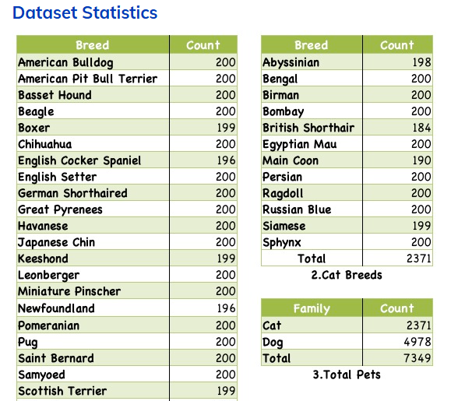
Oxford-IIT pet dataset
The dataset contains 2 species (cat, dog) with 37 breeds. Each class contains around 200 images with different poses

Slide 4
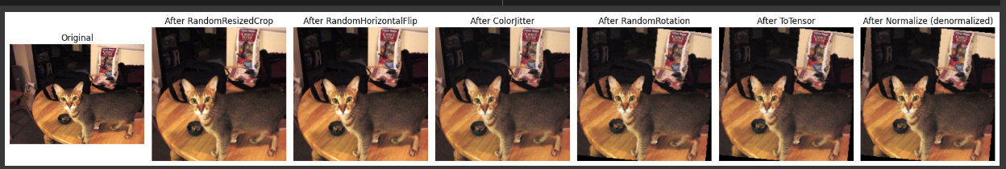
Preprocessing
Resizing
Images were resized to (224,224,3) to improve efficiency
Normalization
To improve model convergence
Data Augmentation
Multiple operations were applied: such as Rotation, Color jittering

Slide 5
Models
Trained
Resnet 34
MobileNet

Slide 6
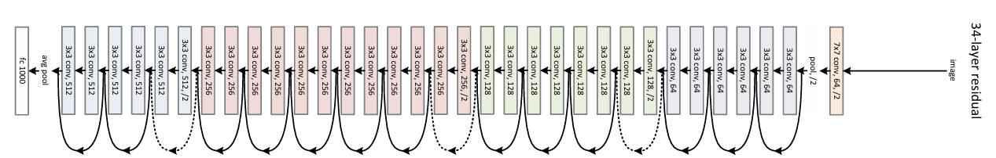
Why ResNet ?
residual connections, which help mitigate the vanishing gradient problem.
Pretrained on ImageNet for Transfer Learning
Efficient Feature Learning

Slide 7
Fine-Tuning
Using the Pre-trained Resnet 34 model
Replace the final FC layer with output layer
Linear layer for the 37 classes
Optimizers used : both Adam and SGD were used
Loss : Cross Entropy
Scheduler : To reduce the lr when it plateaus

Slide 8
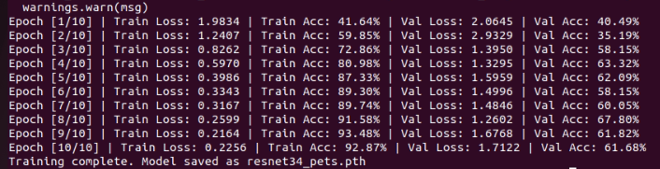
First Try, the model overfits
The Model seems to have learned the training data too well.
Let’s add : Dropout, increase transformations in Data augmentation and lr scheduling

Slide 9

The model generalizes well
After the previous modifications and with changing the optimizer (Adam -> SGD)
The model performs much better now .

Slide 10
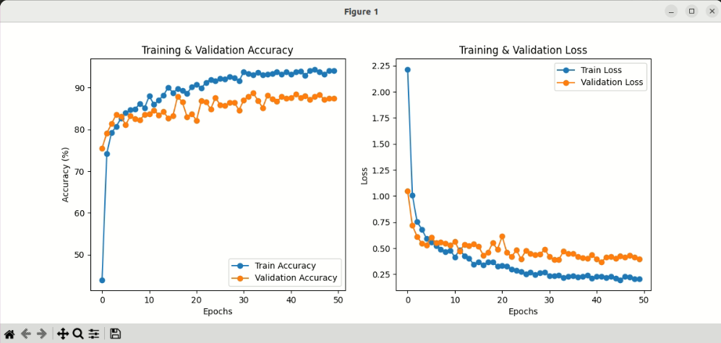
Training & Validation over Epochs

Slide 11
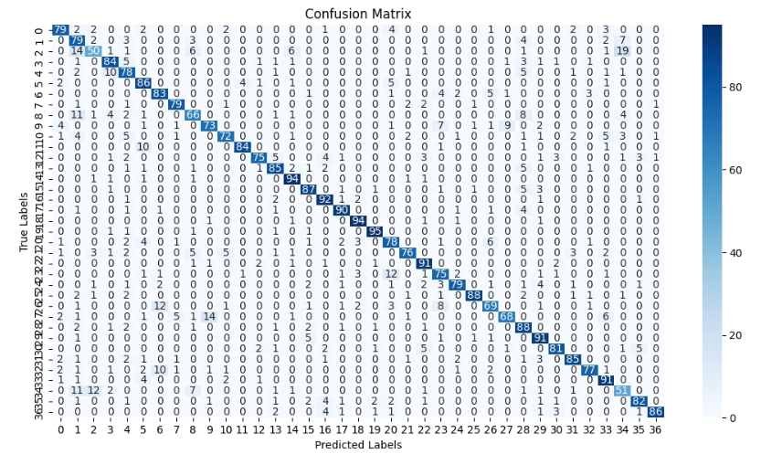
Confusion Matrix

Slide 12
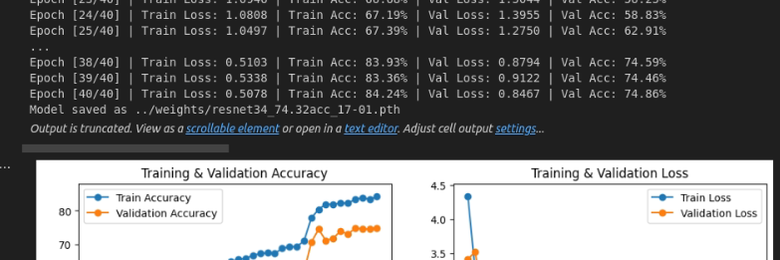
MobileNet
Trying a simpler model.
(Initial Run) —--> Training Acc : 84 %, Val Acc : 74%

Slide 13
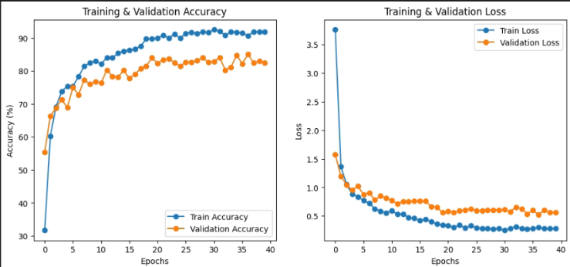
MobileNet (Performance Improvement)
Trying the following to enhance the performance:
Unfreezing some/all the layers
Changing the LR
Training Acc: 91%
Val Acc : 82 %

Slide 14
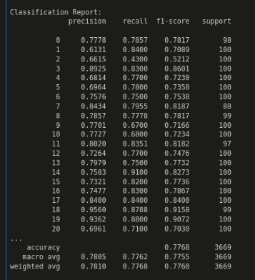
Performance
on test set

Slide 15
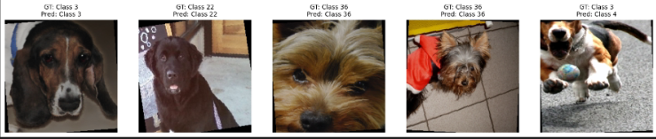
Sample Test (ResNet)
Here are sample test that shows the predicted class and Ground Truth class

Slide 16
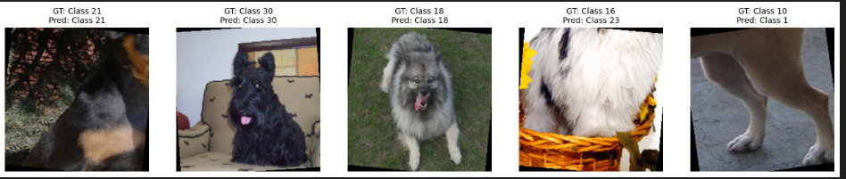
Sample Test (MobileNet)
Here are sample test that shows the predicted class and Ground Truth class

Slide 17
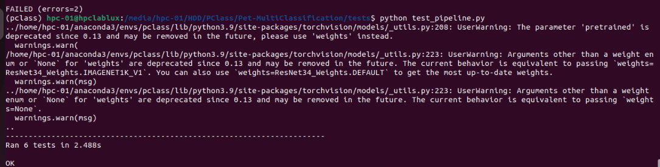
Testing the Pipeline
Testing 3 components:
Data Processing : ensures that data is correctly loaded and in correct shape
Model Training : Sets up the model, does a forward pass, ensure the training runs without problems
Model Testing : loads the trained model, runs a test, ensures correct output shape

Slide 18
Setting up CI pipeline
Running tests automatically on new commits

Slide 19
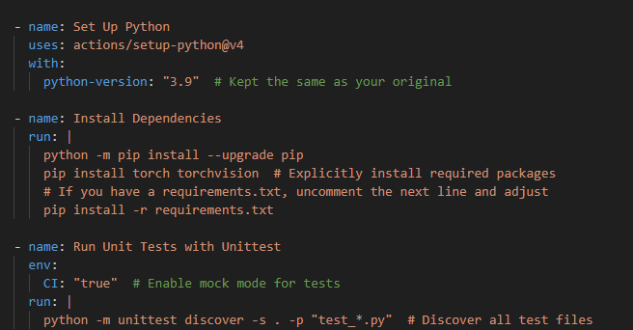
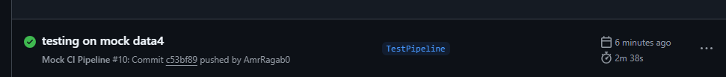
Setting up CI pipeline
Added a ci.yml file to github workflows that does the following:
Gets triggered automatically on new commits
Install the requirements
Runs the Test pipeline code to ensure correct data loading , model training and model testing

Slide 20
Model Optimization
Using ONNX inference

Slide 21
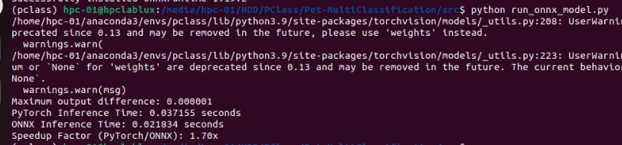
Onnx inference
To speed up the model inference, We convert to ONNX.
The ONNX version is 1.7x (70%) faster than pytorch version.

Slide 22
Future Work
More optimizations:
Using TensorRT
Pruning, Quantization
Knowledge Distillation
Tensor board
To keep track of each experiment

Slide 23
Questions?

